Slide 1
AMC 8 Preparation
SDMC Euler class
Instructor: David Balmin
dbalmin@gmail.com

Slide 2
Introduction
No calculators are allowed at AMC tests.
Approximately 10 first problems of each AMC 8 test can be solved without using pencil and paper.

Slide 3
Introduction
Visit http://amc.maa.org:
“AMC Archives” –> “AMC 8” –> “Brochure Sample Questions”
Publications -> “AMC 8 Math Club Package 2009” with the large collection of AMC problems and solutions.

Slide 4
Introduction
Practice to answer questions 1 through 15 of each test.
Try to solve these problems as fast as you can.
If you can consistently answer questions 1 through 15 correctly, concentrate on solving problems 16 through 25.

Slide 5
Focus
We will focus in this class on solving several selected AMC 8 problems that are instructive and cover different topics.
We will start with reviewing some math theory and methods that can help you solve AMC 8 test problems.

Slide 6
Permutations
Permutations – collections of n distinguishable objects arranged in different order.
For example:
1,2,3; 1,3,2; 2,3,1; 2,1,3; 3,2,1; 3,1,2

Slide 7
Permutations
The number of all different permutations of n objects is n! = 1*2*3*…*n.
We can prove it using the method of mathematical induction.

Slide 8
Permutations
For n = 2, there are 2! = 2 permutations of 2 objects: 1,2 and 2,1.
If the number of all permutations of n-1 objects is (n-1)! and we add one more object to any permutation of n-1 objects, it can be inserted in any one of n places in it:
#1, #2, …, #n.

Slide 9
Permutations
While the new object is in any of n places, the number of permutations of n-1 other objects in their n-1 places is (n-1)!
Thus, the number of all different permutations of n objects equals (n-1)!*n = n!

Slide 10
Combinations
Combinations – selections of k objects from n objects (the order of the objects in each selection is not important).
For example, any 3 students can be selected from 100 students in the auditorium to distribute materials.
In how many ways can such selections be made?

Slide 11
Combinations
The total number of combinations of k objects from n objects, denoted C(n, k), is usually pronounced: “n choose k”.
How can we construct all combinations of k objects from n objects?
We can select the first k objects in each of n! permutations of n objects.

Slide 12
Combinations
For each such selection, there are k! permutations of the first k objects and (n-k)! permutations of the remaining n-k objects.
k!*(n-k)! permutations per each combination.
C(n, k) = n!/(k!*(n-k)!) = n*(n-1)*…*(n-k+1)/k!
For example, C(100, 3) = 100*99*98/3! = 50*33*98.

Slide 13
Combinations
Notice also that C(n, k) = C(n, (n-k)) for any whole numbers 0 <= k <= n.
This is intuitively clear since each collection of selected k objects out of n objects corresponds to exactly one collection of (n-k) not selected objects, and vice versa.

Slide 14
Combinations
Also, by definition, C(n, 0) = 1.

Slide 15
AMC 8 2010, Problem #25
Every day at school, Jo climbs a flight of 6 stairs. Jo can take stairs 1, 2, or 3 at a time. For example, Jo can climb 3, then 1, then 2 stairs. In how many ways can Jo climb the stairs?
(A) 13 (B) 18 (C) 20 (D) 22 (E) 24

Slide 16
AMC 8 2010, Problem #25
The efficient method of solving this type of combinatorial problems is called “Stars and Bars”.
If we view 6 stairs as 6 “stars” and denote them (* * * * * *), we can also use the concept of dividers (“bars”) that can be placed in the gaps between any two adjacent “stars”.

Slide 17
AMC 8 2010, Problem #25
Let us ignore for a moment the condition that Jo can climb maximum 3 stairs and assume that Jo can climb any number of stairs, including all 6 stairs.
Then, we can easily calculate the numbers of combinations of positions of k bars out of total 5 positions (the gaps between 6 stars), where k = 0, 1, 2, 3, 4, 5.

Slide 18
AMC 8 2010, Problem #25
For example, (*|* *| * * *) represents the case when Jo has climbed 1, then 2, then 3 stairs.

Slide 19
AMC 8 2010, Problem #25
Combinations of k bars, where 0 <= k <= 5:
C(5, 0) = 1
C(5, 1) = 5
C(5, 2) = 10
C(5, 3) = 10
C(5, 4) = 5
C(5, 5) = 1

Slide 20
AMC 8 2010, Problem #25
The total number of all possible combinations of k bars positions, where 0 <= k <= 5:
32.
Now, we must subtract the numbers of combinations of bar positions that violate the condition that the number of contiguous stars cannot be greater than 3.

Slide 21
AMC 8 2010, Problem #25
C(5, 0) = 1 (* * * * * *) has 6 contiguous stars. This is invalid. We must count 1 invalid combination.
C(5, 1) = 5 (* * * | * * *) has only one valid combination. We must count 4 invalid combinations.

Slide 22
AMC 8 2010, Problem #25
C(5, 2) = 10 has 3 invalid combinations:
(*|*|* * * *)
(* * * *|*|*)
(*|** * *|*)

Slide 23
AMC 8 2010, Problem #25
All the other combinations in the remaining three cases, C(5, 3), C(5, 4), and C(5, 5), are valid.
The total number of invalid combinations is 8.
Thus, the answer to the problem’s question is 32 – 8 = 24.
Answer: (E).

Slide 24
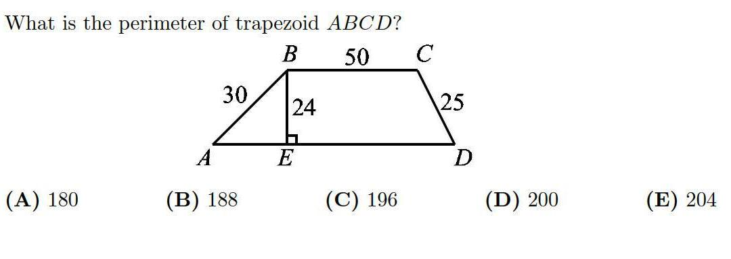
AMC 8 2005, Problem #19

Slide 25
AMC 8 2005, Problem #19
Hint: side lengths 30 and 24 have common factor 6.
If we divide these two side lengths by 6, the similar right triangle with side lengths 5 and 4 will be 3-4-5 triangle.
So, the length of side AE is 3 * 6 = 18.

Slide 26
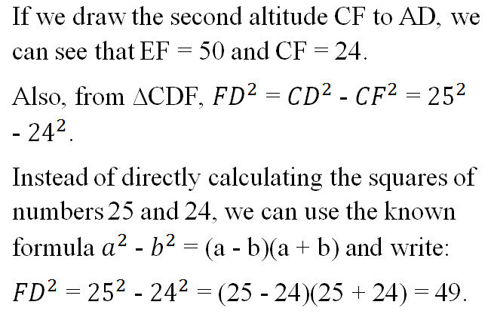
AMC 8 2005, Problem #19

Slide 27
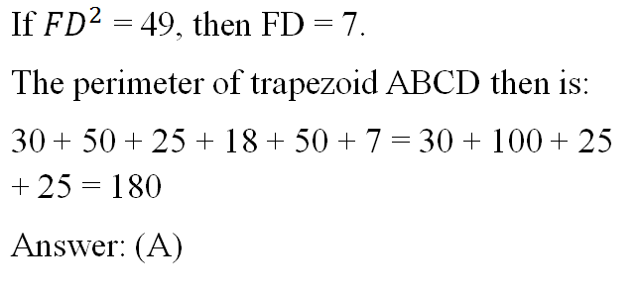
AMC 8 2005, Problem #19

Slide 28
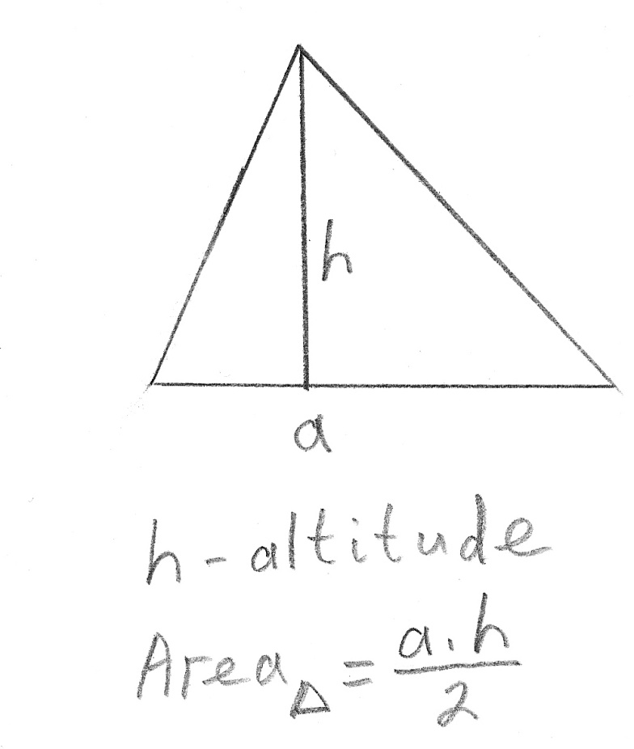
Triangles

Slide 29
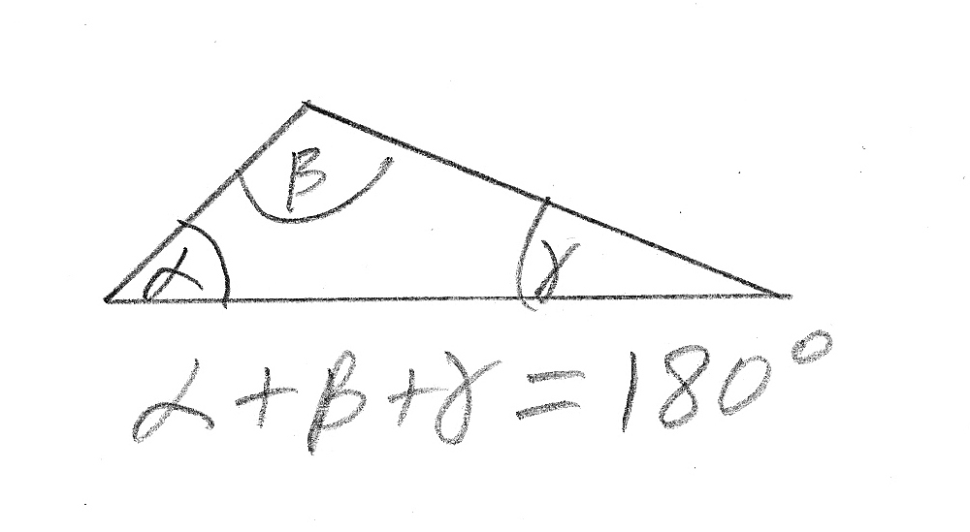
Triangles

Slide 30
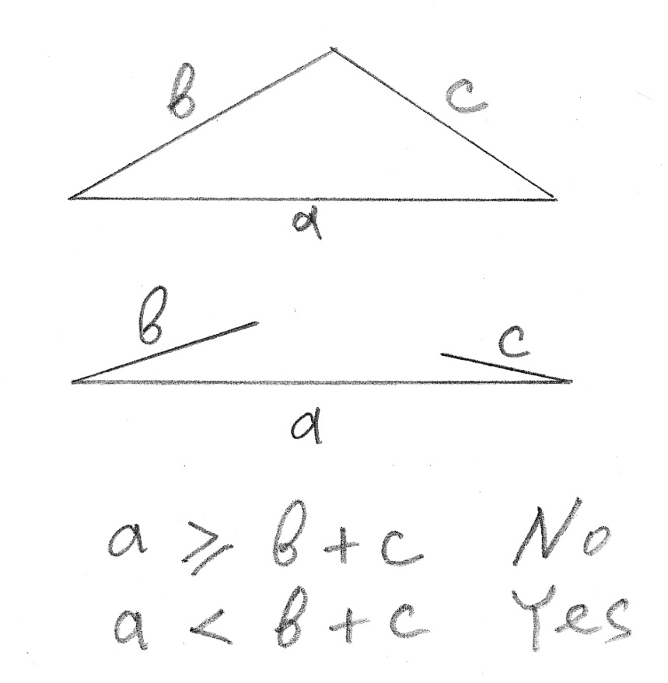
Triangle Inequality Theorem

Slide 31
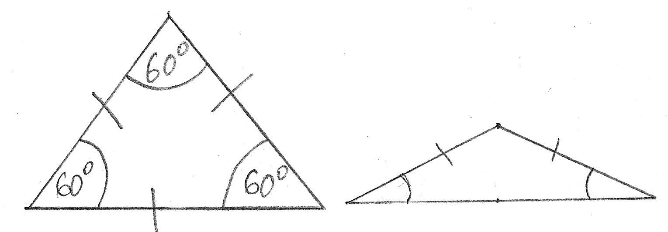
Equilateral and Isosceles Triangles

Slide 32
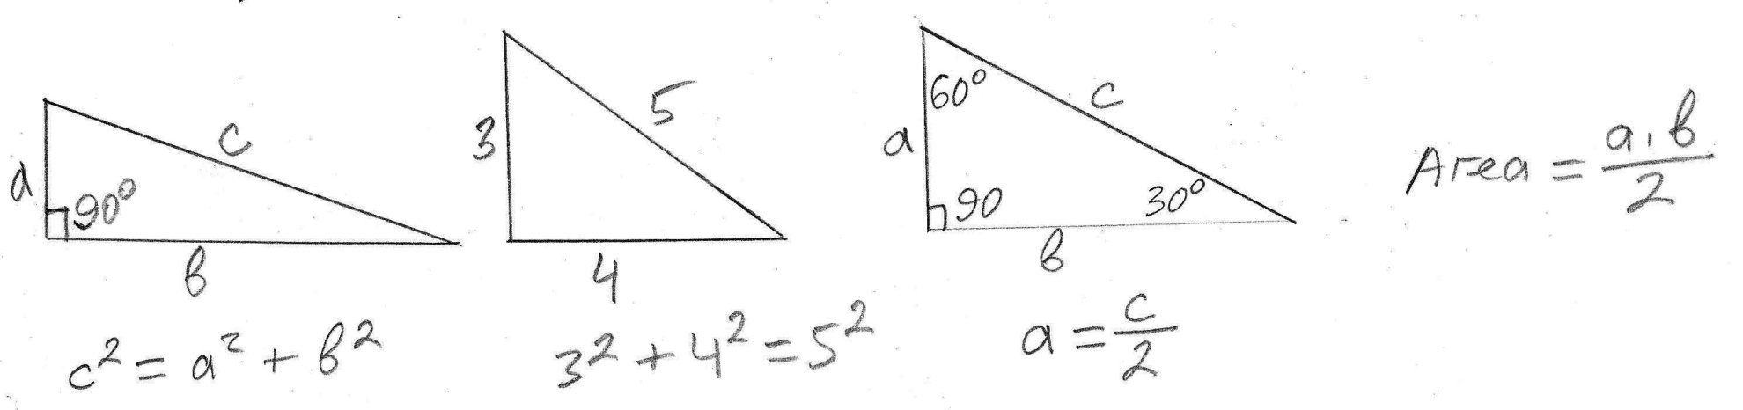
Right Triangles

Slide 33
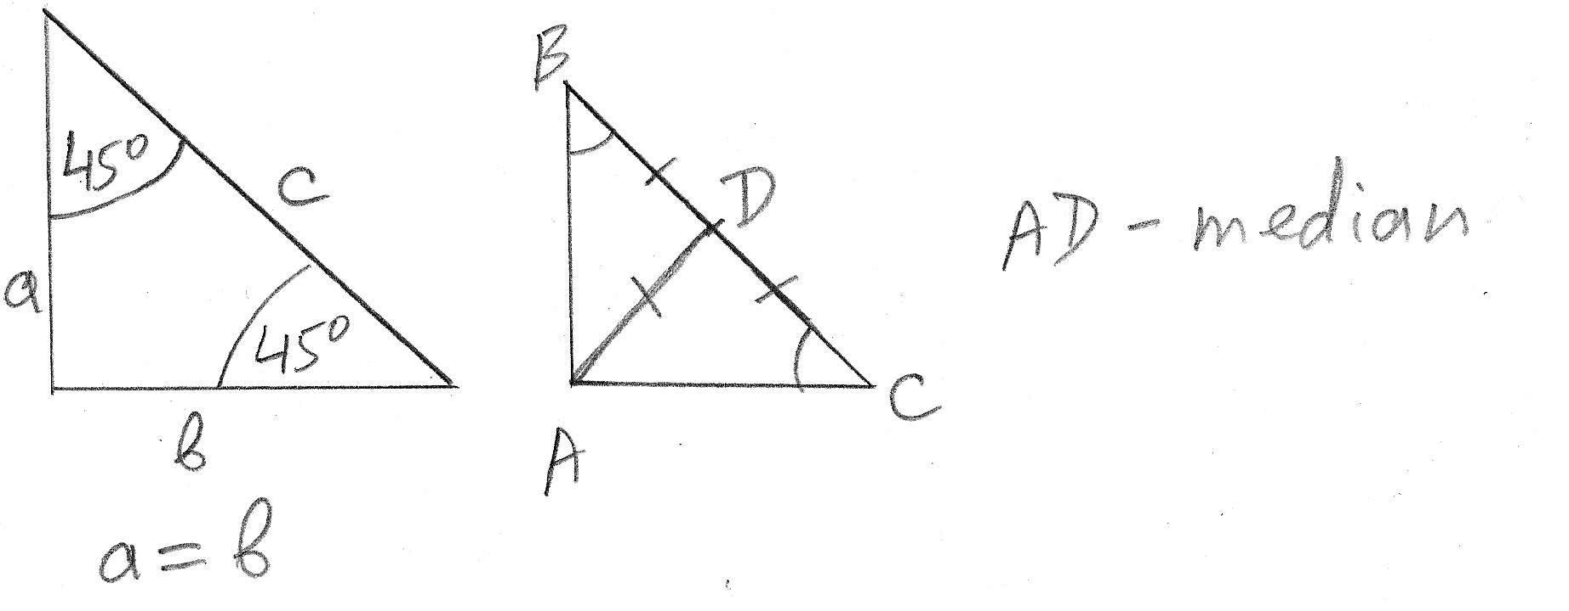
Right Triangles

Slide 34
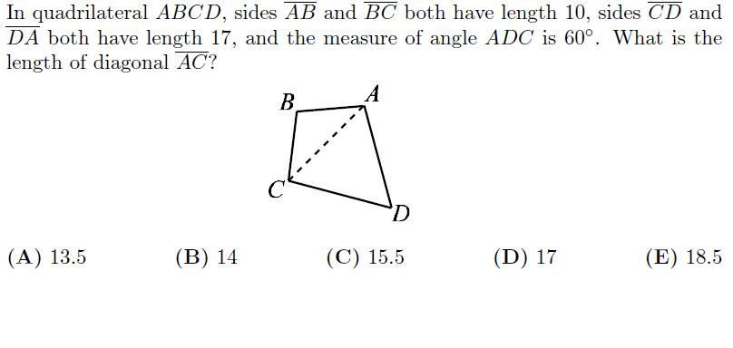
AMC 8 2005, Problem #9

Slide 35
AMC 8 2005, Problem #9
Triangle ACD is isosceles.
Therefore, angles ACD and ADC have equal measures.
Triangle ACD is equilateral (60-60-60).
The length of AC = 17.
Answer (D).

Slide 36
AMC 12 2011, Problem #13
Triangle ABC has side-lengths AB = 12, BC = 24, and AC = 18. The line through the incenter of ∆ABC parallel to BC intersects AB at M and AC at N. What is the perimeter of ∆AMN?
(A) 27 (B) 30 (C) 33 (D) 36 (E) 42

Slide 37
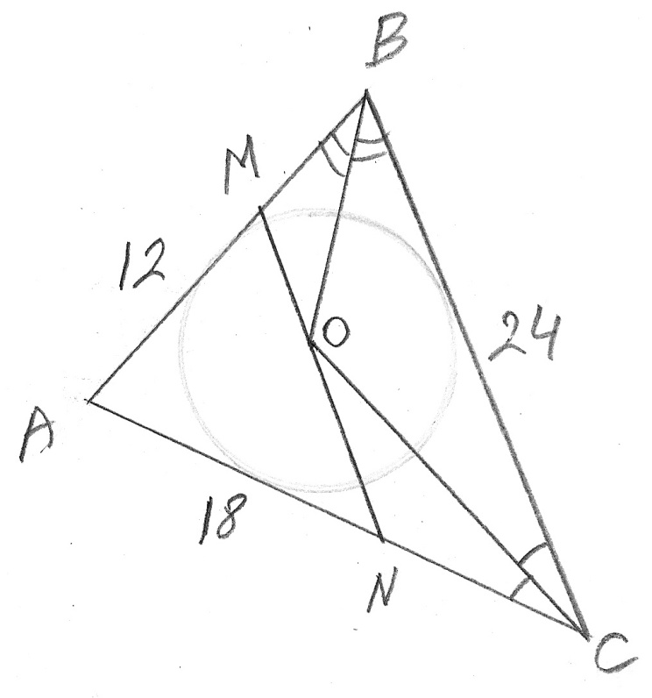
AMC 12 2011, Problem #13

Slide 38
AMC 12 2011, Problem #13
Hint: The alternate interior angles between two parallel lines and a transversal line have equal measures.
So, ∠MOB = ∠OBC.
So, ∠MOB = ∠MBO.

Slide 39
AMC 12 2011, Problem #13
So, triangle OMB is isosceles.
MB = MO.
For the same reason, NC = NO.

Slide 40
AMC 12 2011, Problem #13
The perimeter of ∆AMN is:
AM + AN + MN =
AM + AN + MO + ON =
= AB + AC =
= 12 + 18 = 30.
Answer: (B)

Slide 41
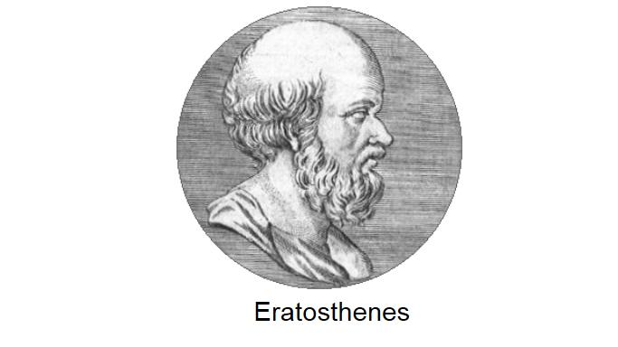
Eratosthenes

Slide 42
Eratosthenes
Circa 200 BC, the Greek mathematician Eratosthenes invented the brilliant method of measuring the circumference of Earth, based on his knowledge of geometry and astronomy.
His method is a good example of finding the “smart way” instead of the “hard way” to solve a difficult problem.

Slide 43
Eratosthenes
As shown in the diagram, he needed to measure the angle φ between the two radii of the Earth pointing to the cities Alexandria and Syene in Egypt.

Slide 44
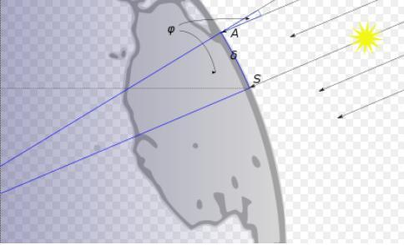
Eratosthenes

Slide 45
Eratosthenes
The direct (hard) way would have been to measure angle φ from the center of the Earth. ☹
But the smart way that Eratosthenes invented was to measure the same angle φ between the sun ray and the lighthouse in Alexandria at noon time on the day of summer solstice, when the Sun was at the zenith in Syene.

Slide 46
Eratosthenes
Using geometry of parallel lines, he calculated that the distance from Alexandria to Syene must be ≈ 7/360 of the total circumference of the Earth.

Slide 47
Eratosthenes
The measurement of the distance between Alexandria and Syene was based on the estimated average speed of a caravan of camels that traveled this distance.
It is generally believed that Eratosthenes' value corresponds to between 39,690 km and 46,620 km., which is now measured at 40,008 km. Eratosthenes result is surprisingly accurate.

Slide 48
Probability
Experiment
Outcomes – Sample space
Probability of the desired event: P
The number of all possible outcomes: N
The number of distinct ways (outcomes) the desired event can occur: M
P = M / N

Slide 49
Probability – Example 1
Experiment: tossing a coin.
All possible outcomes: heads or tails.
The desired event: a coin landing on heads.
Probability of the desired event: 1/2.

Slide 50
Probability – Example 2
Experiment: throwing a dice with 6 faces.
All possible outcomes: numbers 1 through 6.
The desired event: an odd number.
Probability of the desired event: 3/6 = 1/2.

Slide 51
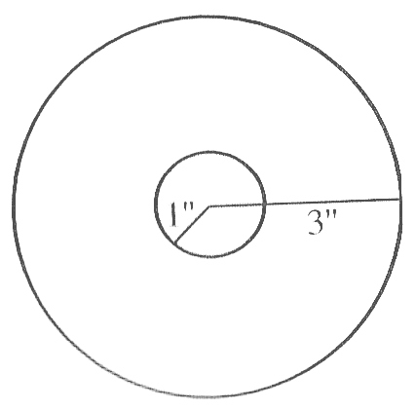
Probability – Example 3

Slide 52
Probability – Example 3
Experiment: random shooting at the big circle.
All possible outcomes: hitting target anywhere inside the big circle.
The desired event: hitting target anywhere inside the small circle.
Probability of the desired event: Pi*1 / Pi*9 = 1/9.

Slide 53
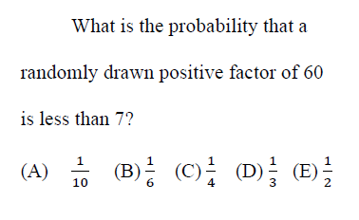
AMC 12A 2003, Problem #8

Slide 54
AMC 12A 2003, Problem #8
All factors of 60:
1, 2, 3, 4, 5, 6, 10, 12, 15, 20, 30, 60.
The number of all factors is 12.

Slide 55
AMC 12A 2003, Problem #8
The number of all factors that are less than 7 is 6.
The probability: 6/12 = 1/2.
Answer: (E).

Slide 56
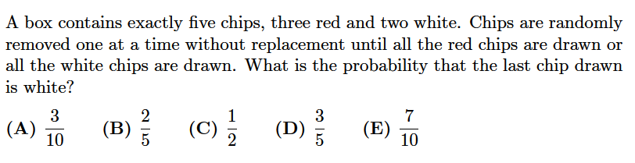
AMC 12 2001, Problem #11

Slide 57
AMC 12 2001, Problem #11
This problem illustrates the power of a smart transformation of the problem’s question to a different question that is easier to answer.

Slide 58
AMC 12 2001, Problem #11
The drawings can stop at drawing #2, drawing #3, or, “worst case”, drawing #4.
Suppose that we complete all 5 drawings, regardless of the results of the first 4 drawings.
We can define two mutually-exclusive results of the first 4 drawings: A and B.

Slide 59
AMC 12 2001, Problem #11
Result A: all the white chips have been drawn during the first 4 drawings.
Result B: all the red chips have been drawn during the first 4 drawings.
Then, the question in this problem can be re-phrased as:
“What is the probability of result A?”

Slide 60
AMC 12 2001, Problem #11
Result A is possible if and only if the remaining chip drawn in the 5th drawing is red.
Thus, the initial question in this problem can be further rephrased as:
“What is the probability that the chip drawn in the 5th drawing is red?”

Slide 61
AMC 12 2001, Problem #11
The probability that the chip drawn in the 5th drawing is red equals 3/5.
Answer: (D).

Slide 62
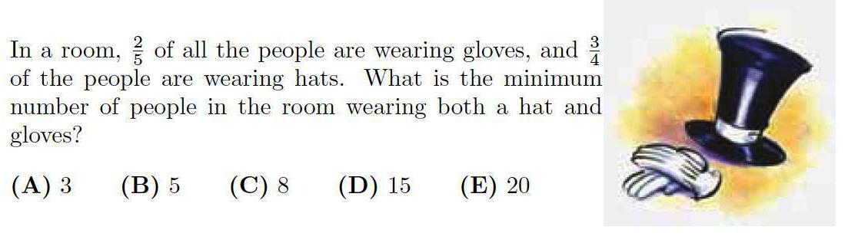
AMC 8 2010, Problem #20

Slide 63
AMC 8 2010, Problem #20
First of all, we need to calculate the minimum number of people in the room.
The fractions 2/5 and 3/4 correspond to the numbers of people wearing gloves and hats respectively.
The minimum number of people in the room equals the least common denominator of these two fractions: 20.

Slide 64
AMC 8 2010, Problem #20
Now, we can calculate the number of people wearing gloves, 20 * 2/5 = 8,
and the number of people wearing hats,
20 * 3/4 = 15.
We can use the “worst case” method to answer the question of the problem.

Slide 65
AMC 8 2010, Problem #20
In the “best case”, 8 people wear both gloves and a hat, 7 people wear hats and no gloves, and 5 people wear neither gloves nor hats.
However, in the “worst case”, 3 people must wear both gloves and a hat; then 5 people wear gloves and no hats, and 12 people wear hats and no gloves.
Answer: (A).

Slide 66
Speed-Distance-Time Problem
Two grandmas started travelling toward each other at dawn: first grandma from A to B and the other from B to A. Each grandma maintained steady speed during the entire trip. They met at noon and continued travelling without a pause. First grandma reached point B at 4 PM; the other grandma reached point A at 9 PM. What was the time of dawn that day?

Slide 67
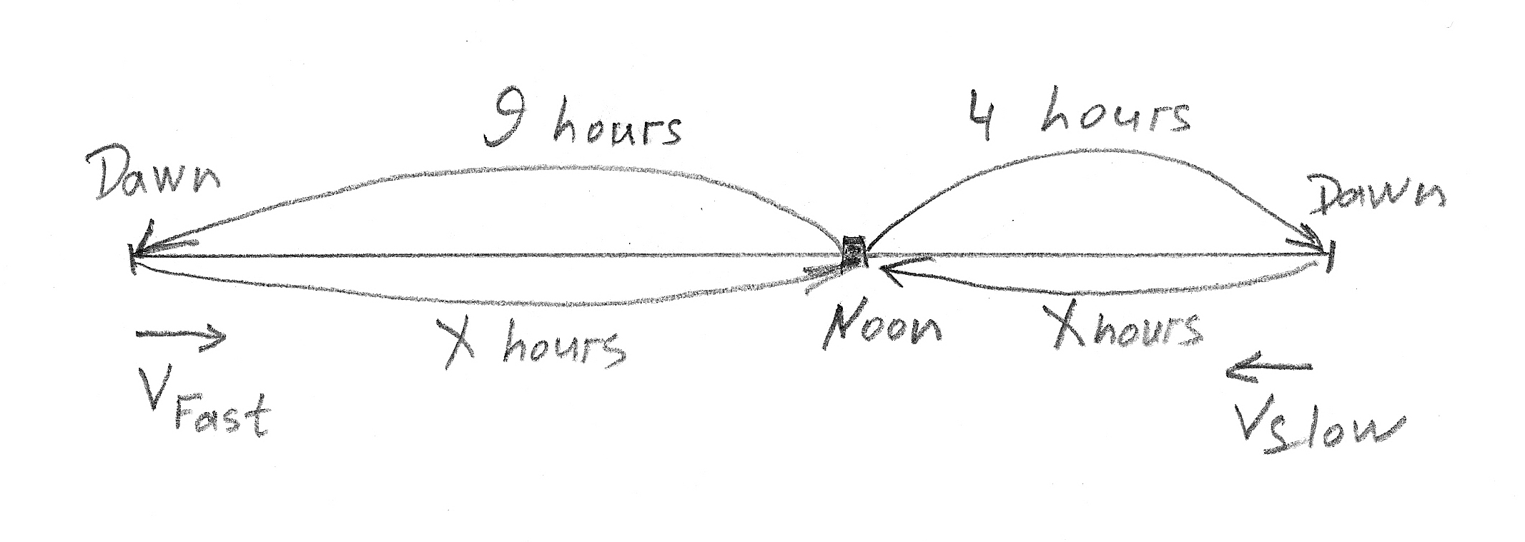
Speed-Distance-Time Problem

Slide 68
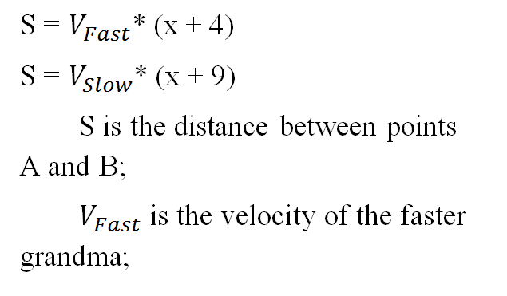
Speed-Distance-Time Problem

Slide 69
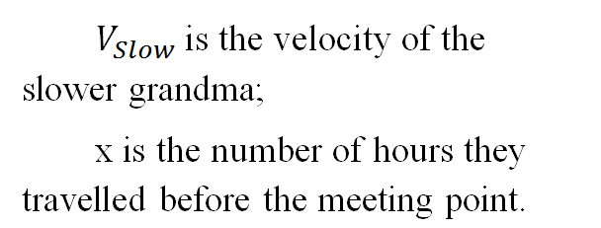
Speed-Distance-Time Problem

Slide 70
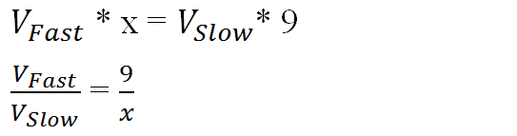
Speed-Distance-Time Problem

Slide 71
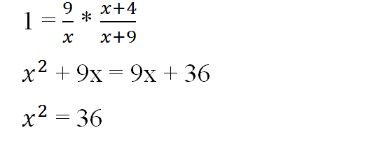
Speed-Distance-Time Problem

Slide 72
Speed-Distance-Time Problem
X = 6
Answer: 6 am.

Slide 73
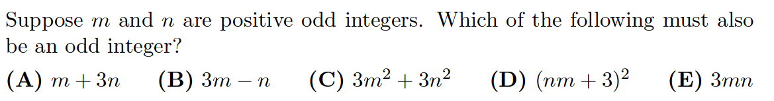
AMC 8 2005, Problem #8

Slide 74
AMC 8 2005, Problem #8
This is an example of how the multiple-choice answers can be used creatively.
Since we need to choose the formula that has odd values for all positive odd n and m, then one counter example for a given formula eliminates that formula.

Slide 75
AMC 8 2005, Problem #8
If we simply calculate each formula in A, B, C, D, and E for n = 1 and m = 1, then A, B, C, and D produce even numbers and can be eliminated.
Only the formula in answer E produces odd number that makes it the clear winner.
Answer: (E).

Slide 76
AMC 8 2005, Problem #8
Of course, it is not hard to solve this problem using the rules of math for odd and even numbers.
Whichever method works better for you during the test is fine, as long as it is correct.

Slide 77
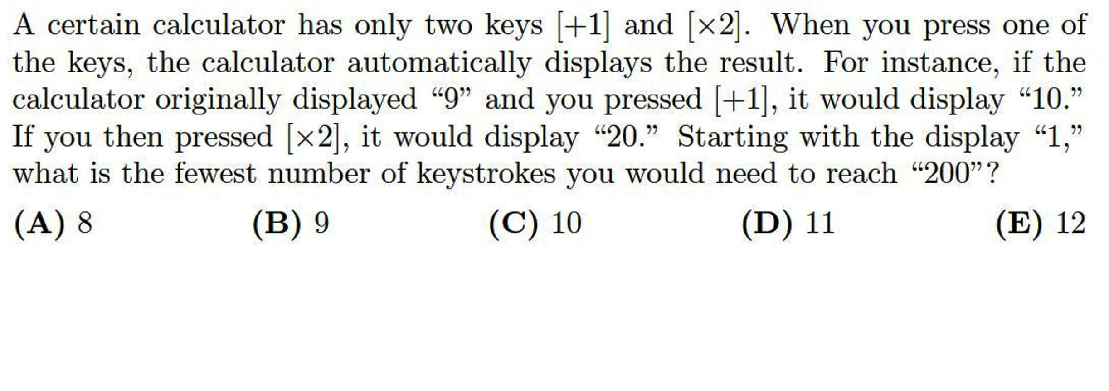
AMC 8 2005, Problem #24

Slide 78
AMC 8 2005, Problem #24
Hint: start from the end and work backward.
Since the only available operations are “+1” and “*2”, the reverse operations are “-1” and “/2”.

Slide 79
AMC 8 2005, Problem #24
Clearly, we want to divide 200 by 2 and continue to repeat this operation as long as the result numbers are even.
We get numbers 100, 50, 25.
Since 25 is odd, the only choice is to subtract 1. We get 24.
Now, we can start dividing numbers by 2 again. We get numbers 12, 6, 3.

Slide 80
AMC 8 2005, Problem #24
3 is odd. So, the last two reversed operations result in numbers 2 and 1.
Now, we can write the same numbers in the ascending order and count the forward operations: 1, 2, 3, 6, 12, 24, 25, 50, 100, 200.
The number of operations is 9.
Answer: (B)

Slide 81
AMC 8 2005, Problem #24
Prove that 8 operations suggested in answer (A) cannot result in 200.
If all 8 operations are “*2”:
2*2*2*2*2*2*2*2 = 256 > 200
If we replace any one operation “*2” with “+1”:
3*64 = 192 < 200

Slide 82
AMC 8 2005, Problem #24
5*32 = 160 < 200
9*16 = 144 < 200
17*8 = 136 < 200
33*4 = 132 < 200
65*2 = 130 < 200
It’s obvious that replacing the second “*2” operation with “+1” (after replacing the first one) will only reduce the final result.

Slide 83
Factoring Problem
In how many ways is it possible to factor number 36 into sets of three natural numbers (e.g., 1, 2, 18) ?
Note: the order of factors in each set of three numbers is not important.
(A) 8 (B) 9 (C) 10 (D) 12 (E) 15

Slide 84
Factoring Problem
The factors of 36 are:
1, 2, 3, 4, 6, 9, 12, 18, 36 .

Slide 85
Factoring Problem
There are 5 distinct pairs of factors of 36:
(1, 36)
(2, 18)
(3, 12)
(4, 9)
(6, 6)

Slide 86
Factoring Problem
1 = 1 * 1 (1 * 1 * 36 = 36)
2 = 1 * 2 (1 * 2 * 18 = 36)
3 = 1 * 3 (1 * 3 * 12 = 36)
4 = 1 * 4 (1 * 4 * 9 = 36)
4 = 2 * 2 (2 * 2 * 9 = 36)
6 = 1 * 6 (1 * 6 * 6 = 36)
6 = 2 * 3 (2 * 3 * 6 = 36)

Slide 87
Factoring Problem
9 = 3 * 3 (4 * 3 * 3 = 36)
The total number of sets of three factors of 36 is 8.
Answer: (A)

Slide 88
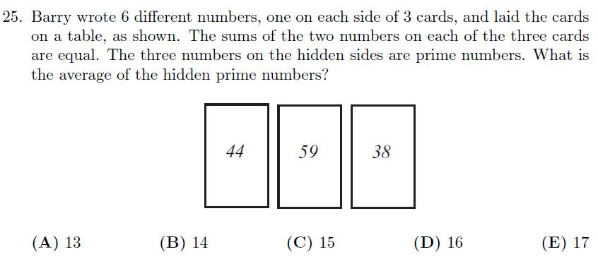
AMC 12A 2006, Problem #25

Slide 89
AMC 12A 2006, Problem #25
The common sum must be odd since 44 and 38 are even and all prime numbers (except 2) are odd.
59 is odd. Therefore, its prime number is 2.
The common sum is 59 +2 = 61.

Slide 90
AMC 12A 2006, Problem #25
Two others primes are 61 – 44 = 17 and 61 – 38 = 23.
The average of primes is (2+17+23)/3 = 14
Answer: (B)

Slide 91
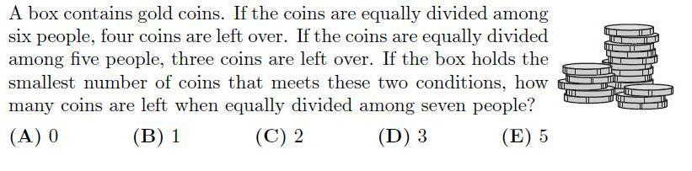
AMC 12A 2006, Problem #23

Slide 92
AMC 12A 2006, Problem #23
After dividing among 6 people, 4 coins are left. Add 2 coins to make the total divisible by 6.
After dividing among 5 people, 3 coins are left. Again, add 2 coins to make the total divisible by 5.
The LCM of 6 and 5 is 30.

Slide 93
AMC 12A 2006, Problem #23
The number of coins in the box is 30 - 2 = 28.
28 is divisible by 7.
Answer: (A).

Slide 94
AMC 12A 2002, Problem #21
Consider the sequence of numbers: 4, 7, 1, 8, 9, 7, 6, …. For n > 2, the nth term of the sequence is the units digits of the sum of the two previous terms. Let denote the sum of the first n terms of this sequence. The smallest value of n for which > 10,000 is:
(A) 1992 (B) 1999 (C) 2001 (D) 2002
(E) 2004

Slide 95
AMC 12A 2002, Problem #21
4, 7, 1, 8, 9, 7, 6, 3, 9, 2, 1, 3, 4, 7.
The sum of the first 12 members is 60.
If we divide 10,000 by 60:
166 complete 12-blocks of members.

Slide 96
AMC 12A 2002, Problem #21
166 * 60 = 9,960 = 10,000 - 40
4+7+1+8+9+7 = 36 < 40 (6 members)
4+7+1+8+9+7+6 = 42 > 40 (7 members)
166*12 + 7 = 1,999
Answer: (B)

